Slide 1
GOLD HILL MESA METROPOLITAN DISTRICT NO. 2 ANNUAL TOWN HALL MEETING
November 16, 2023, at 5:00 pm
Gold Hill Mesa Conference Room – and – Virtual Option Available

Slide 2
AGENDA
Call to Order
Current Public Infrastructure Projects
Current Bond Status
Review Current Year to Last Month Unaudited Financial Statements
Review Budget Status for 2024
Questions
Adjourn

Slide 3
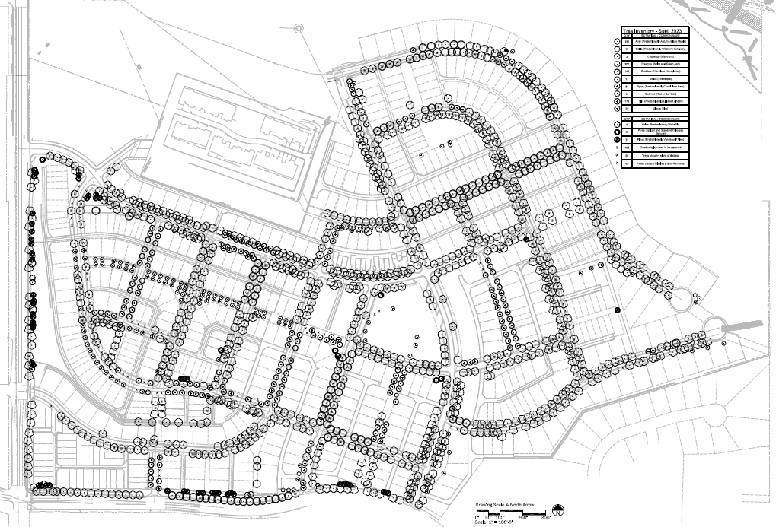
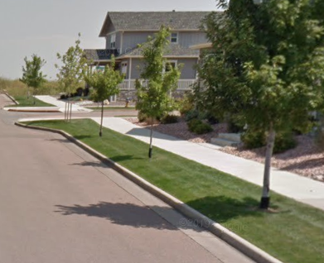
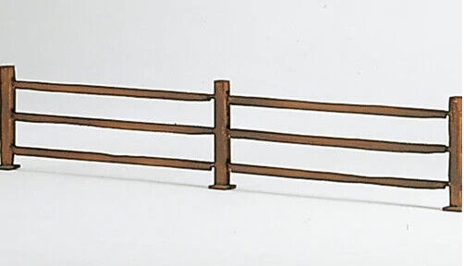
Agenda Item 2) Current Public Infrastructure Projects
The District’s Current Planned Infrastructure Project Include:
Removing Dead Trees
Replace Dead Trees that were removed
Add Split Rail fence along 21st St and at the end of Lady Campbell Dr
Utilize the approved $25,000 matching Grant fund to replace struggling tree lawns with more water-wise landscaping

Slide 4
Agenda Item 3) Current Bond Status
Bond Amounts | Lender/Trustee | Interest Rate | Issued | BALANCE AS OF 12/31/2023
Series 2022A: $12,525,000 Maturity Date: Dec. 1, 2048 | UMB BANK | 5% | 6/8/2022 | $11,125,000.00
Series 2022B: $4,847,000 Maturity Date: Dec. 15, 2039 | UMB BANK | 7% | 6/8/2022 | $4,670,000.00
2024 Certified Operations & Maintenance Mill Levy 11.366 | 2024 Certified Debt Service Mill Levy 34.099
How to Calculate your Property Taxes:
Market Value of your home X (times) Residential Assessment Rate (RAR) = Assessed Valuation (AV) AV x (times) Mill Levy Rate ÷ (divided by) 1,000 = Annual Property Tax | EXAMPLE: Home Value is $500,000 $500,000 x 6.765% (current RAR) = 33,825 (AV) 33,825 x 45.465 (current mill levy) = 1,537,853.63 ÷ 1,000 = $1,537.85/ year

Slide 5
Agenda Item 4) Unaudited Financial Statements – Balance Sheet as of 10/31/2023
 |  |  |  |  | Oct 31, 23
ASSETS
 | Current Assets
 |  | Checking/Savings
 |  |  | First Bank Checking |  | 1,827,610.33
 |  |  | UMB Senior Bond Fund - 8486.1 |  | 936.23
 |  |  | UMB Reserve Fund - 8486.2 |  | 1,025,595.95
 |  |  | UMB Sub Bond 8487-1 |  | 126.16
 |  |  | UMB Sub Project Fund - 8487.2 |  | 1,930.41
 |  | Total Checking/Savings |  |  | 2,856,199.08
 |  | Total Other Current Assets |  |  | 383.68
 | Total Current Assets |  |  |  | 2,856,582.76
TOTAL ASSETS |  |  |  |  | 2,856,582.76
LIABILITIES & EQUITY
 | Liabilities
 |  | Current Liabilities
 |  |  | Accounts Payable
 |  |  |  | Accounts Payable | 921,258.90
 |  |  | Total Accounts Payable |  | 921,258.90
 |  |  | Other Current Liabilities
 |  |  |  | Due to District 1 | 39,723.75
 |  |  |  | Deferred Prop Tax Rev - O&M | 383.68
 |  |  | Total Other Current Liabilities |  | 40,107.43
 |  | Total Current Liabilities |  |  | 961,366.33
 | Total Liabilities |  |  |  | 961,366.33
 | Equity
 |  | Fund Balance - Debt |  |  | 1,367,383.08
 |  | Retained Earnings |  |  | -105,841.20
 |  | Net Income |  |  | 633,674.55
 | Total Equity |  |  |  | 1,895,216.43
TOTAL LIABILITIES & EQUITY |  |  |  |  | 2,856,582.76

Slide 6
Agenda Item 4) Unaudited Financial Statements – Profit and Loss Budget Comparison as of 10/31/2023 (slide 1 of 2)
 |  |  |  |  | Jan - Oct 23 |  | Budget |  | $ Over Budget |  | % of Budget
 | Ordinary Income/Expense
 |  | Income
 |  |  | Urban Renewal TIF - Debt |  | 1,510,500.79 |  | 1,497,010.00 |  | 13,490.79 |  | 100.9%
 |  |  | Urban Renewal TIF O&M |  | 226,003.96 |  | 223,691.00 |  | 2,312.96 |  | 101.03%
 |  |  | Interest Income - Debt |  | 40,529.79
 |  |  | CY Property Tax - O&M |  | 2,856.24 |  | 3,237.00 |  | -380.76 |  | 88.24%
 |  |  | Delinquent Interest - O&M |  | -53.47
 |  |  | Prior Year Tax - O&M |  | 0.03
 |  |  | Specific Ownership Tax - O&M |  | 12,760.05 |  | 20,384.00 |  | -7,623.95 |  | 62.6%
 |  |  | CY Property Tax - Debt |  | 11,424.95 |  | 9,712.00 |  | 1,712.95 |  | 117.64%
 |  |  | Delinquent Interest - Debt |  | -13.40
 |  |  | Prior Yr Tax - Debt |  | 0.12
 |  |  | Specifice Ownership Tax - Debt |  | 51,040.11 |  | 61,152.00 |  | -10,111.89 |  | 83.46%
 |  |  | Impact Fees |  | 0.71
 |  | Total Income |  |  | 1,855,049.88 |  | 1,815,186.00 |  | 39,863.88 |  | 102.2%

Slide 7
Agenda Item 4) Unaudited Financial Statements – Profit and Loss Budget Comparison as of 10/31/2023 (slide 2 of 2)
 |  |  |  |  | Jan - Oct 23 |  | Budget |  | $ Over Budget |  | % of Budget
 |  | Expense
 |  |  | Bank Fees |  | 136.00
 |  |  | Contingency |  | 0.00 |  | 1,200.00 |  | -1,200.00 |  | 0.0%
 |  |  | Insurance |  | 2,951.00
 |  |  | Intergovt Expenditures - O&M |  | 0.00 |  | 247,268.00 |  | -247,268.00 |  | 0.0%
 |  |  | Miscellaneous |  | 0.00 |  | 200.00 |  | -200.00 |  | 0.0%
 |  |  | Treasurer Collection Fee - O&M |  | 42.86 |  | 49.00 |  | -6.14 |  | 87.47%
 |  |  | Treasurer Collection Fee - Debt |  | 171.47 |  | 146.00 |  | 25.47 |  | 117.45%
 |  |  | Bond Expense
 |  |  |  | Paying Agent Fee | 0.00 |  | 7,000.00 |  | -7,000.00 |  | 0.0%
 |  |  |  | Bond Interest - Series 2022A | 613,075.00 |  | 613,075.00 |  | 0.00 |  | 100.0%
 |  |  |  | Bond Principal Series 2022A | 605,000.00 |  | 605,000.00 |  | 0.00 |  | 100.0%
 |  |  |  | Bond Interest - Series 2022B(3) | 0.00 |  | 329,350.00 |  | -329,350.00 |  | 0.0%
 |  |  |  | Bond Principal Series 2022B | 0.00 |  | 35,000.00 |  | -35,000.00 |  | 0.0%
 |  |  | Total Bond Expense |  | 1,218,075.00 |  | 1,589,425.00 |  | -371,350.00 |  | 76.64%
 |  | Total Expense |  |  | 1,221,376.33 |  | 1,838,288.00 |  | -616,911.67 |  | 66.44%
 | Net Ordinary Income |  |  |  | 633,673.55 |  | -23,102.00 |  | 656,775.55 |  | -2,742.94%
 | Other Income/Expense
 |  | Total Other Income |  |  | 1.00 |  | 1,205.00 |  | -1,204.00 |  | 0.08%
 | Net Other Income |  |  |  | 1.00 |  | 1,205.00 |  | -1,204.00 |  | 0.08%
Net Income |  |  |  |  | 633,674.55 |  | -21,897.00 |  | 655,571.55 |  | -2,893.89%

Slide 8
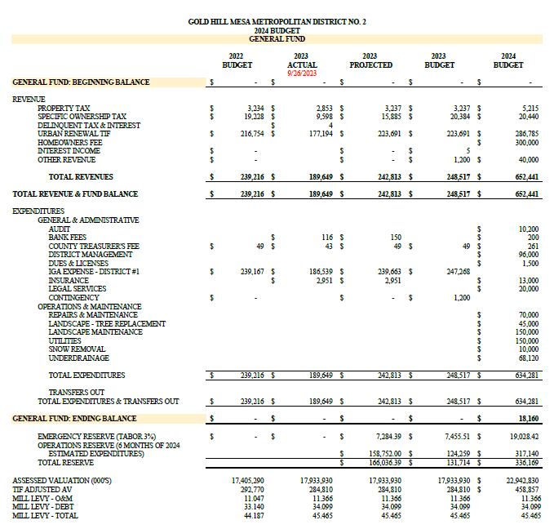
Agenda Item 5) Budget Status for 2024

Slide 9
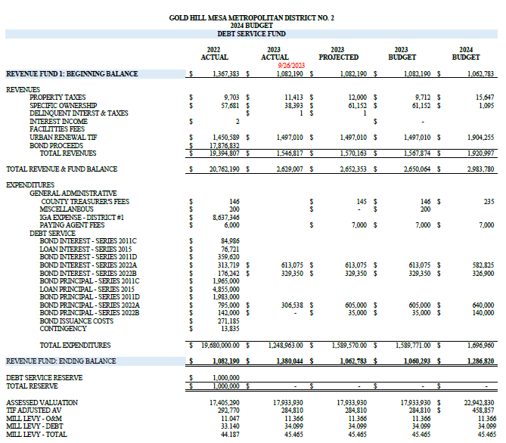
Agenda Item 5) Budget Status for 2024

Slide 10
Questions?

